Slide 1
Citi Bike Data Analysis
By Enrico Carrer

Slide 2
Project Goal:
To better understand the behavior of Citi Bike’s customer base (both one-time users and subscribers) and how they use Citi Bikes
This will help us to:
Identify where more bikes should be installed
Create targeted marketing campaigns that will appeal to different customer segments

Slide 3
Key questions:
What are the most popular pick-up locations across the city for Citi Bike rental?
How does the average trip duration vary across different age groups?
Which age group rents the most bikes?
How does bike rental vary across the two user groups (one-time users vs long-term subscribers) on different days of the week?
Does the factor of user age impact the average bike trip duration?

Slide 4
Findings & Insights

Slide 5
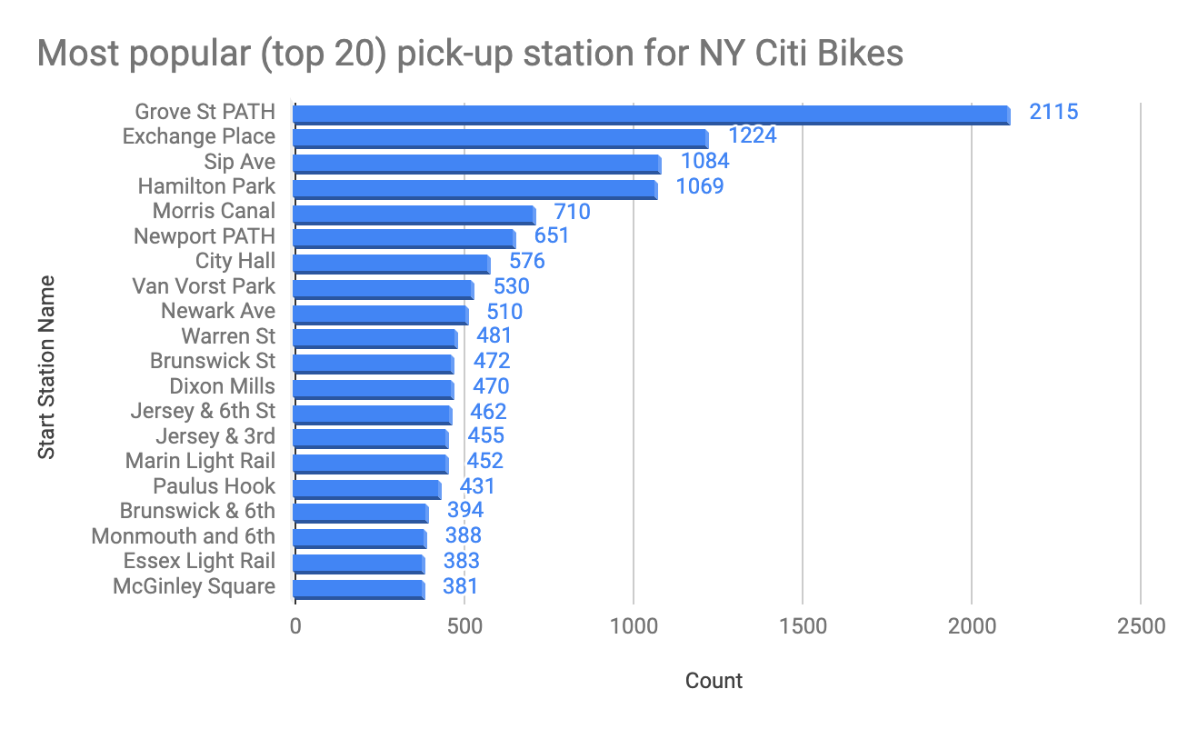
What are the most popular Citi Bike pick-up locations?
Grove St Path is by far the most popular pick-up station
Exchange Place, Sip Ave, Hamilton Park, & Morris Canal complete the top 5.

Slide 6
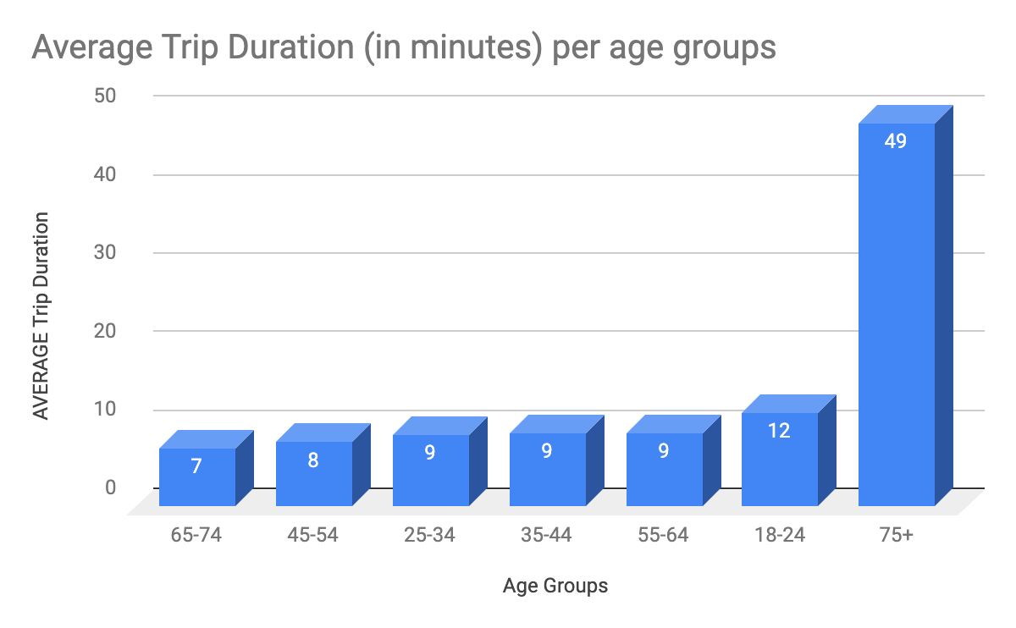
2. How does the average trip duration vary across different age groups?
The 75+ age group tend to do the longest trips on average.
All other groups have similar average trip durations (with the lowest average for the 65-74 age group).

Slide 7
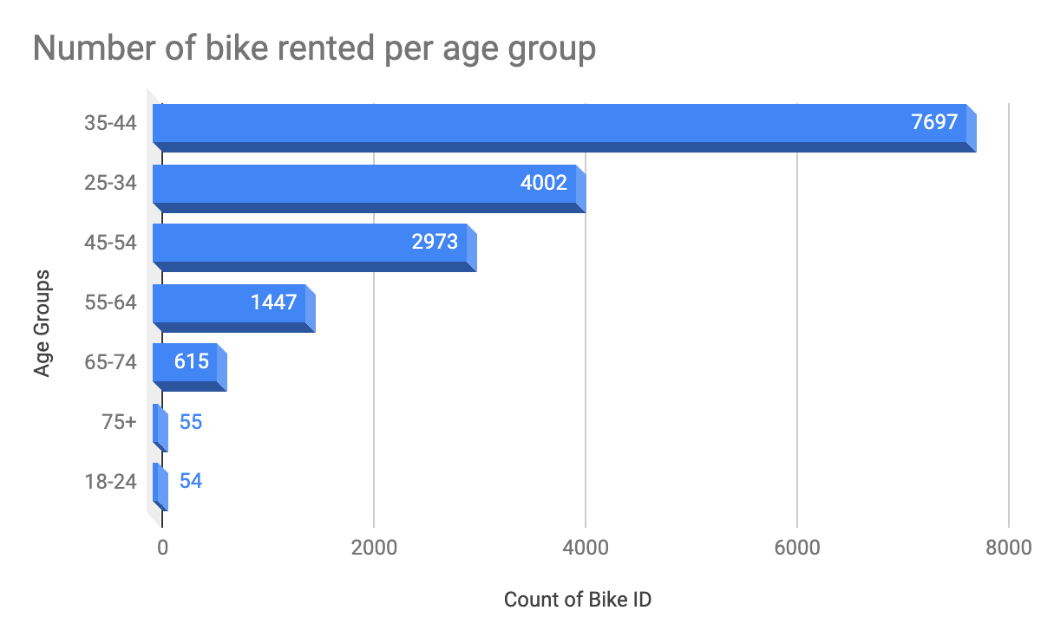
3. Which age group rents the most bikes?
The highest number of bikes were rented by those in the 35-44 age range.
Users aged 18-24 and 75+ rented the least bikes (respectively 54 and 55).

Slide 8
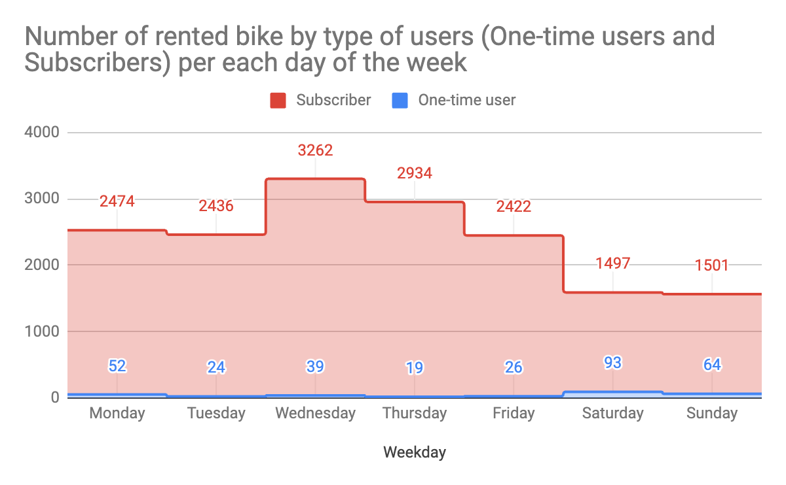
4. How does bike rental vary across the two user groups (one-time users vs long-term subscribers) on different days of the week?
Citi Bike customer base is predominantly made up of long-term subscribers
Subscribers tend to rent the most bikes on weekdays (with a peak on Wednesdays).
One-time users tend to rent during the weekend (with a peak on Saturdays).

Slide 9
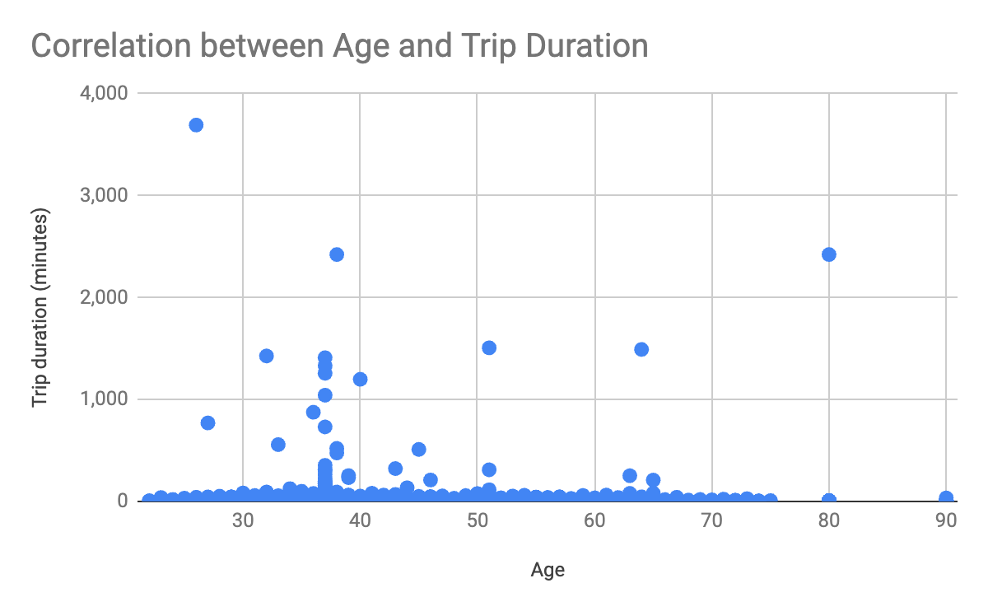
5. Do factors like weather and age impact the average bike trip duration?
there doesn’t seem to be a notable correlation between the user’s age and how long they ride for.

Slide 10
Summary

Slide 11
Summary of findings:
Top 5 pick-up locations for bikes:
Grove St Path, Exchange Place, Sip Ave, Hamilton Park, & Morris Canal
Customer base:
Mostly subscribers
Likely to be workers (commuting?) as they rent predominantly during the weekdays
Mostly aged 25-54
One-time rents are a much smaller part of the customer base, renting mainly during the weekend for leisure.
Citi Bike customer behavior:
Those in the 75+ category tend to take the longest trips on average, while 65-74 year olds take the shortest trips on average.

Slide 12
Actions & Recommendations

Slide 13
Recommended actions:
Product recommendations:
Install more bikes at Grove St Path, Exchange Place, Sip Ave, Hamilton Park.
Marketing recommendations:
The Citi Bike customer base is mostly long-term subscribers, aged between 35 and 44, who are most active during the week. This tells us that they are probably people who live in New York and use Citi Bikes to commute. Marketing and advertising campaigns should therefore target this particular demographic.

Slide 14
Thank you!

